Slide 1
Marketing Analysis
Rashad Yusifov

Slide 2
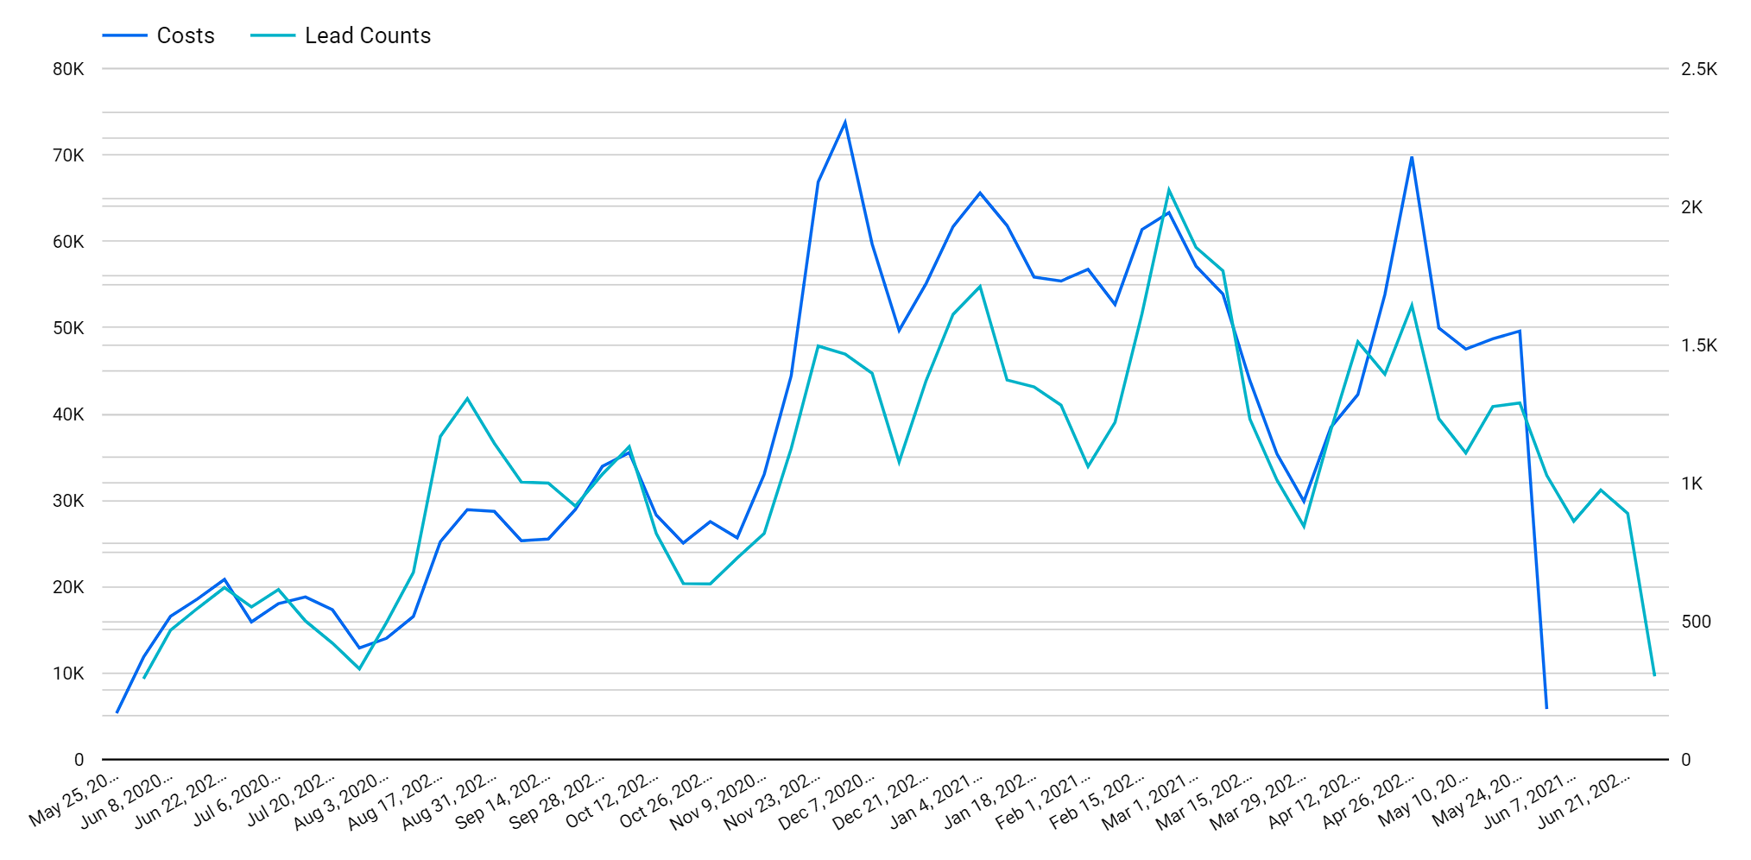
Overall trend by week
Overall, both cost and lead counts show an increasing trend till December 2021 before they fluctuate until May 2021.
There are exponential costs incurred in November 2020, leading to its peak followed by a substantial decrease in March 2021. The most inefficient periods accompany December 2020, and May, 2021 where few lead counts are achieved at maximum costs.

Slide 3
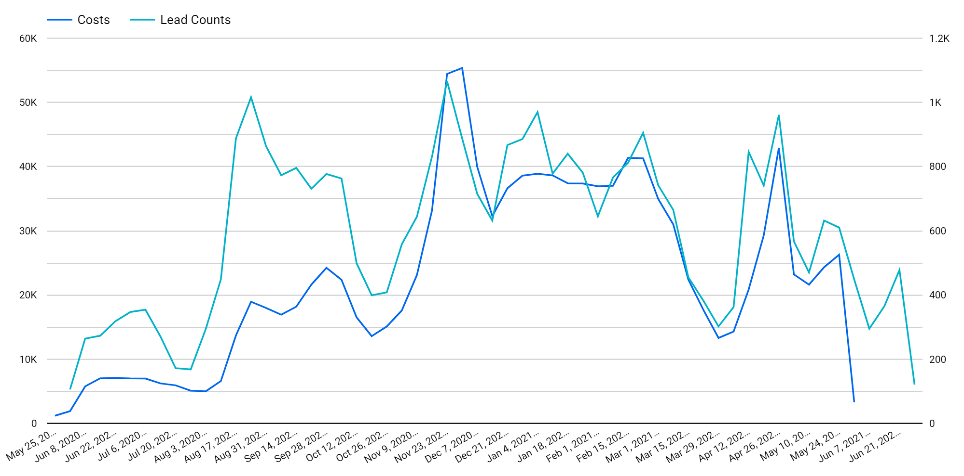
Social channel trend by week
Social channel follows similar trend with huge lead counts at little cost, that generated before October 2020.
The period between Aug, 2020 and Oct, 2020 is the most lucrative period. Lead counts highly correlate with marketing cost for the periods after October 2020.

Slide 4
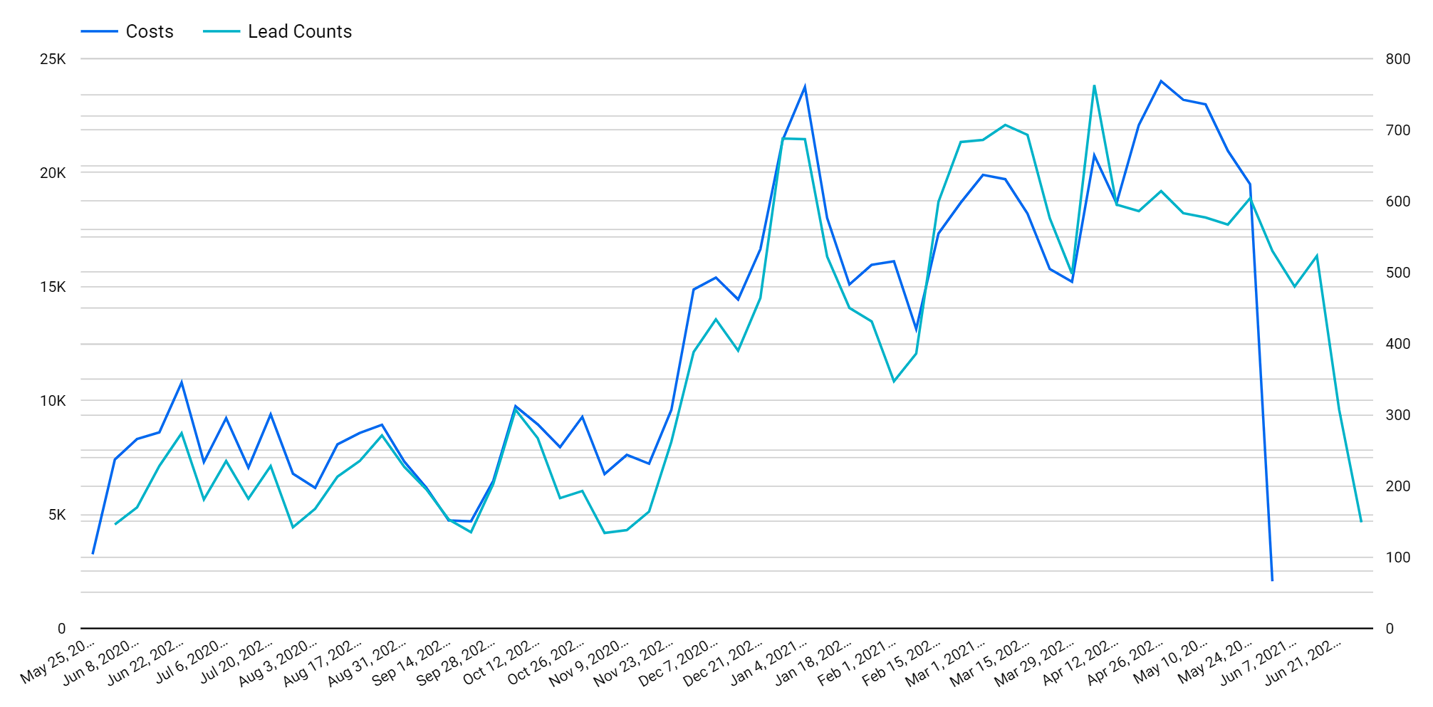
Native channel trend by week
Both lead counts and costs for the Native channel fluctuate between 5k and 10k for the period before November 2020 and peaks in December 2020 and May 2021.
Rise and falls in both cost and lead counts accompany the same period for Native channel except the period April 26 – May 24, 2021.

Slide 5
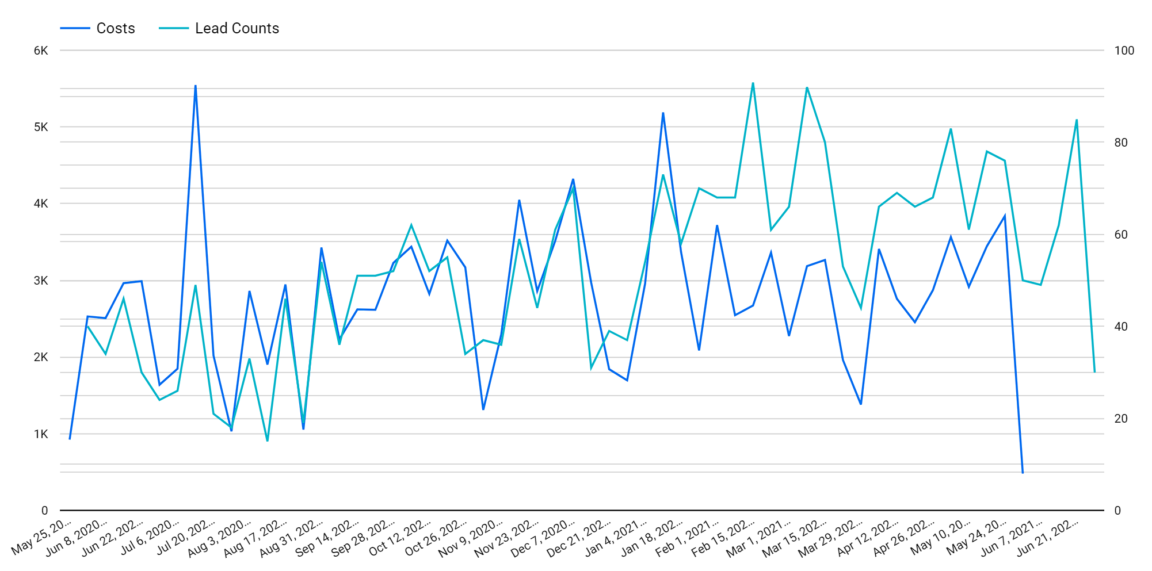
Search channel trend by week
Search channel follows a different trend with constant ups and downs with peak cost in July 2020.
The cost and lead closely match until February 2021. The gain increases for the periods after February, 2021 as maximum lead counts are achieved at less cost.

Slide 6
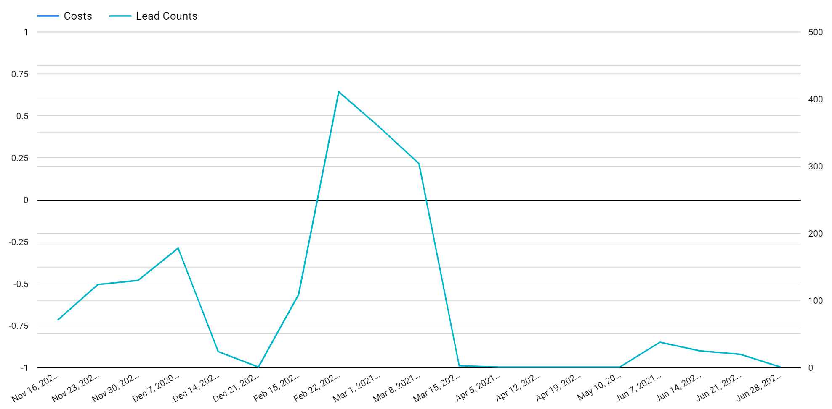
Google Display Channel Trend by week
Google Display does not have sufficient cost data and the lead count is sporadic with most data is collected between November 2020 and March 2021.

Slide 7
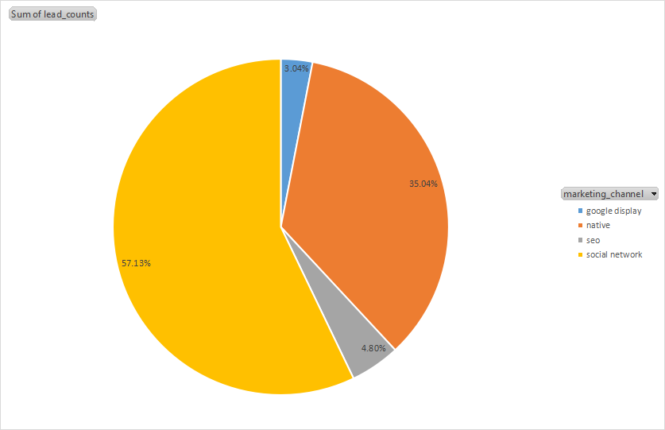
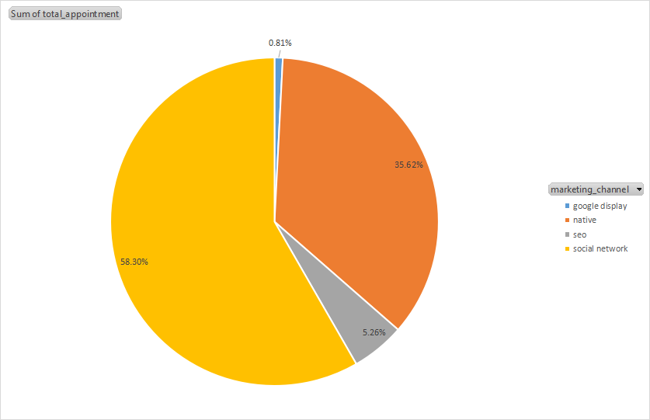
Breakdown by Channel
In terms of conversion from lead to appointment, Google Display ranks last dropping from 3.04% total lead to 0.81% total appointment, while other channels slightly higher.

Slide 8
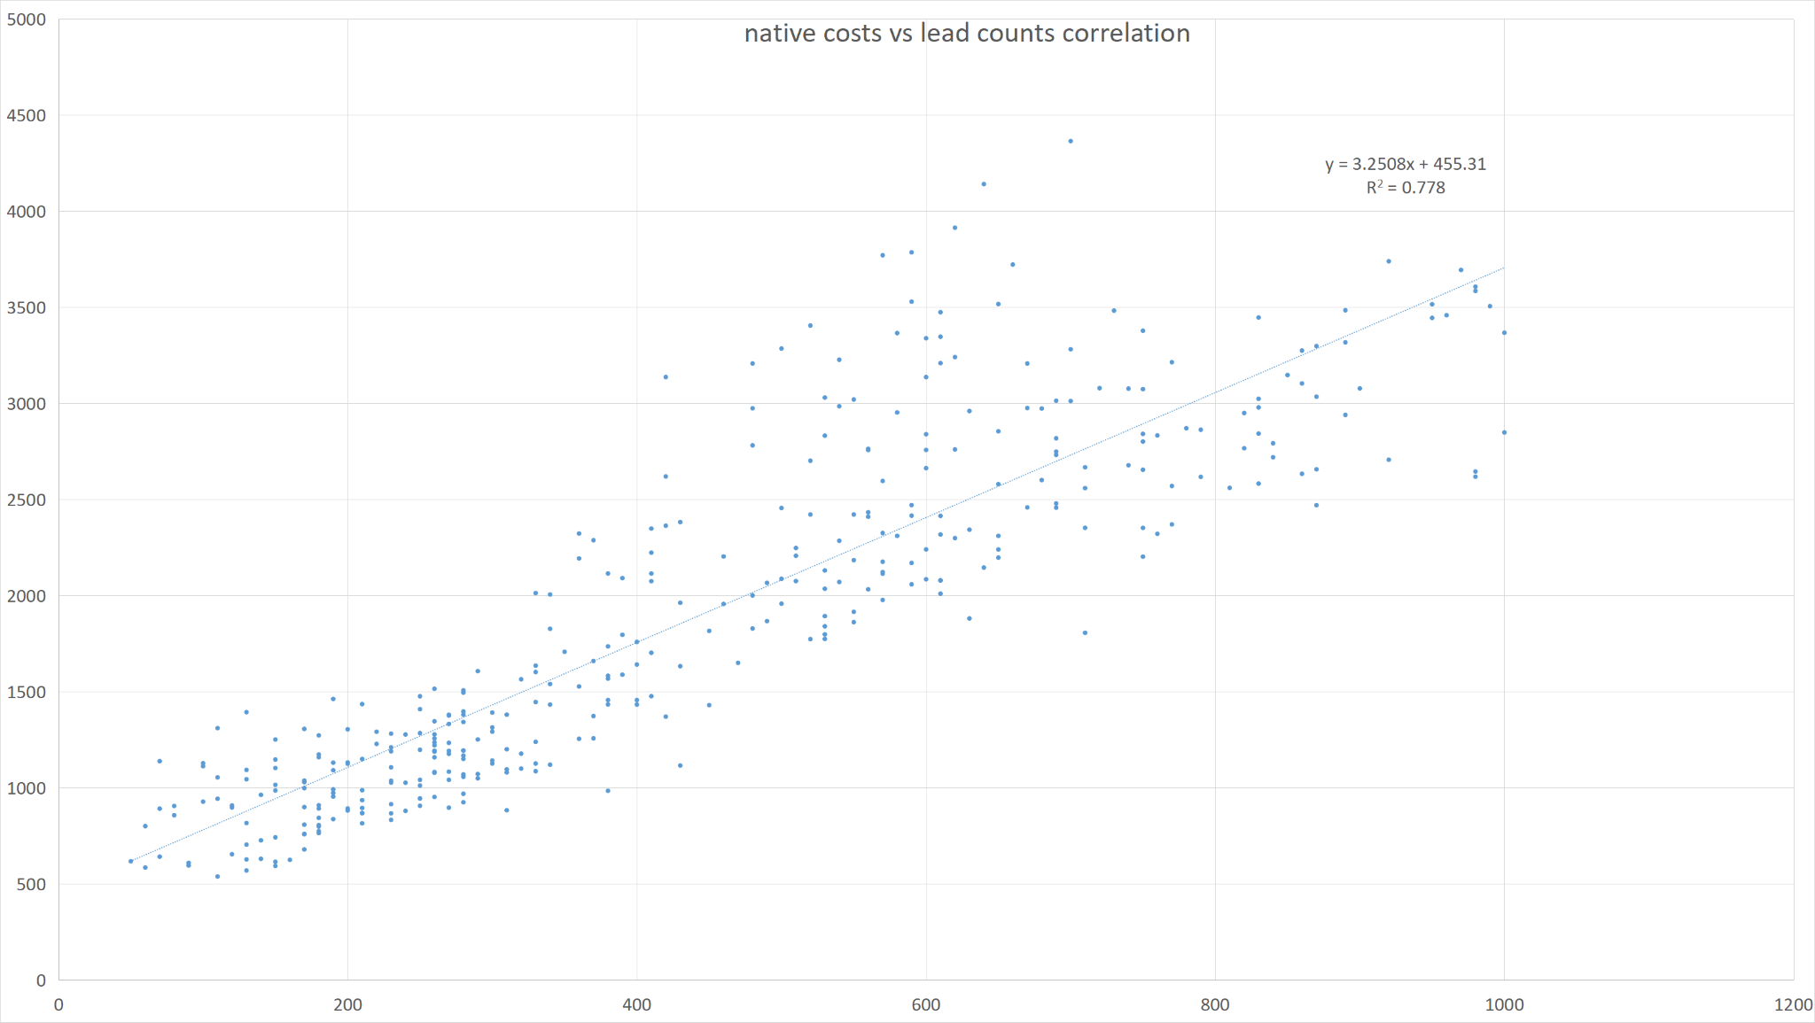
Lead vs Cost Correlation by channel - Native
High Correlation at 0.778
Every dollar/euro spend returns 3.25 leads.

Slide 9
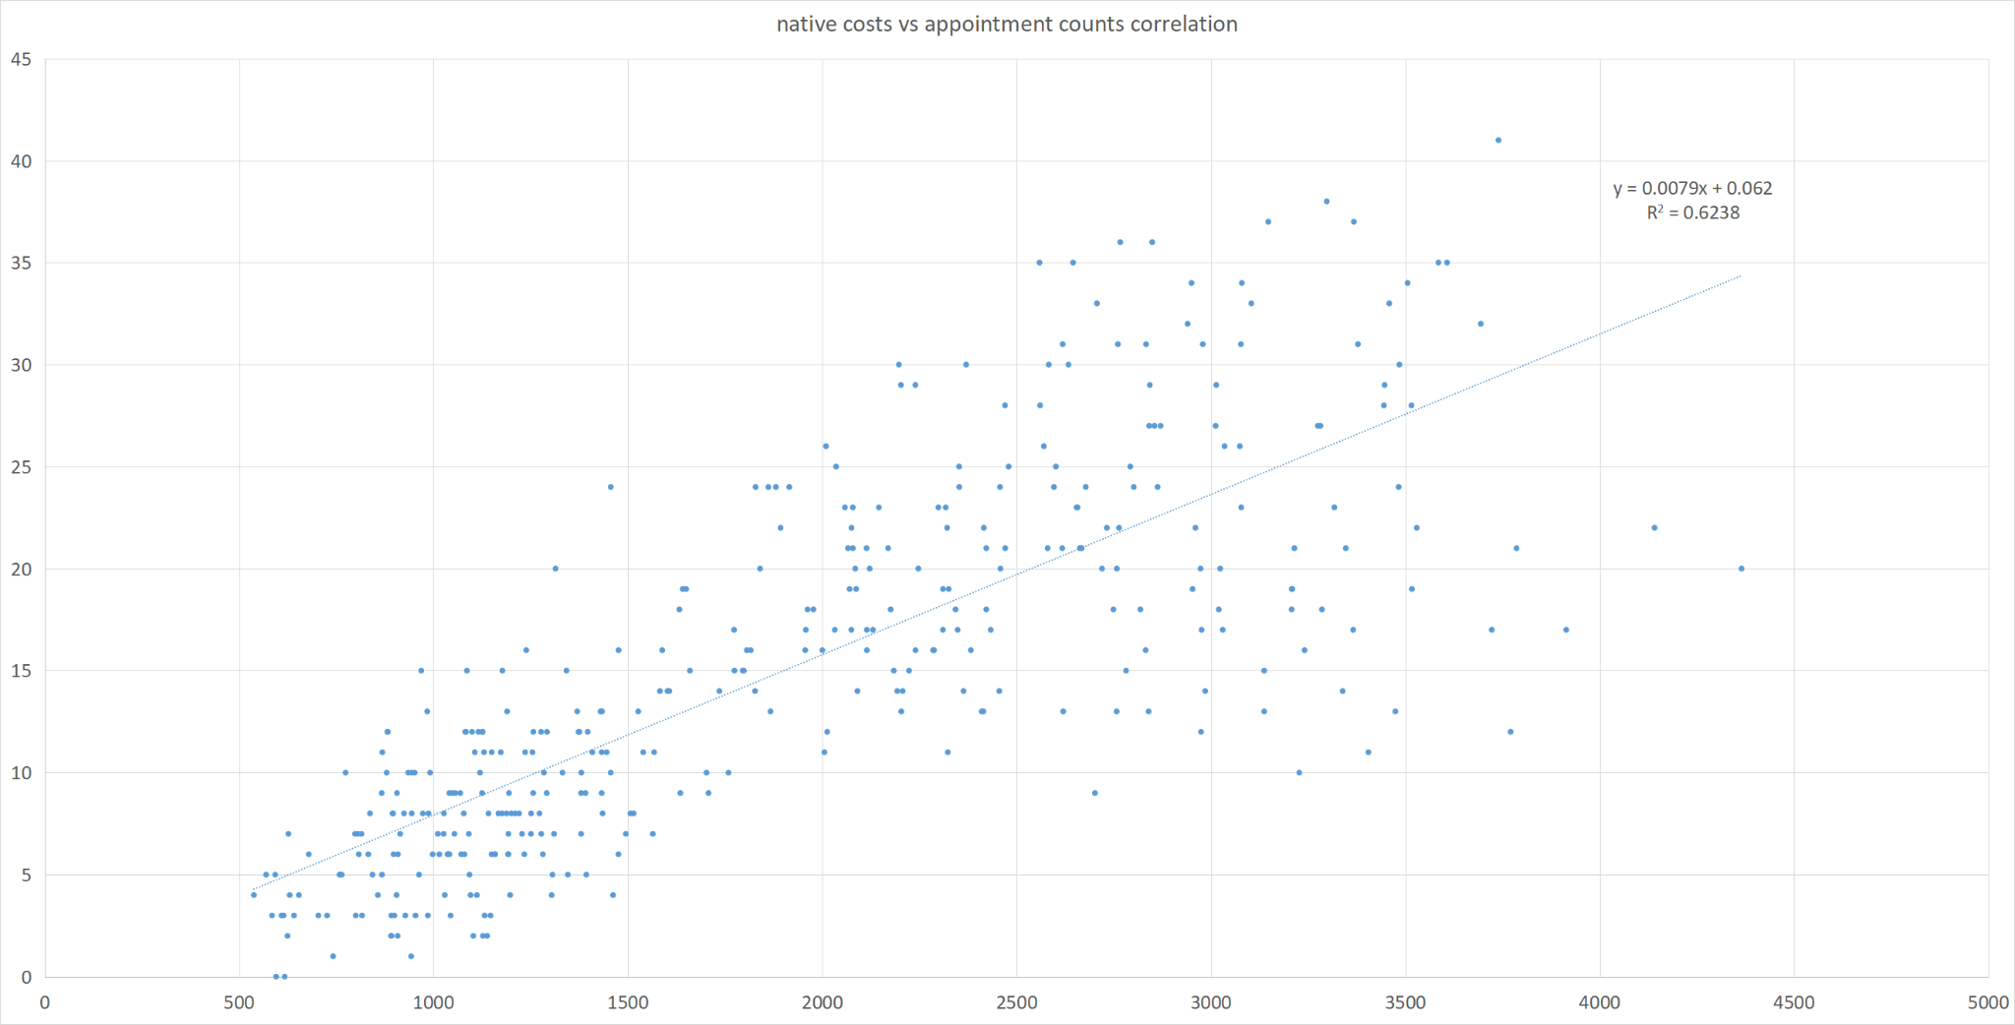
Appointment vs Cost Correlation by channel - Native
Medium Correlation at 0.6238
Every dollar/euro spend returns 0.0079 appointment.

Slide 10
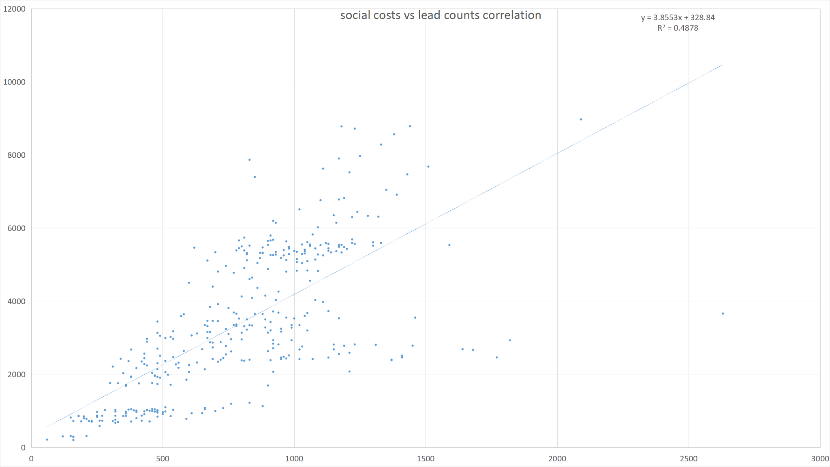
Lead vs Cost Correlation by channel - Social
Medium Correlation at 0.4878
Every dollar/euro spend returns 3.855 leads.

Slide 11
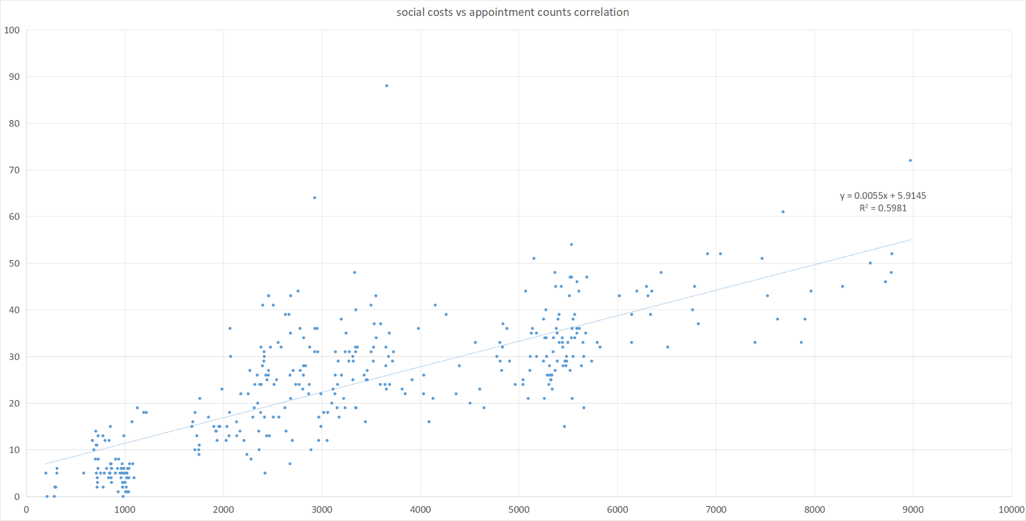
Appointment vs Cost Correlation by channel - Social
Medium Correlation at 0.5981
Every dollar/euro spend returns 0.0055 appointment.

Slide 12
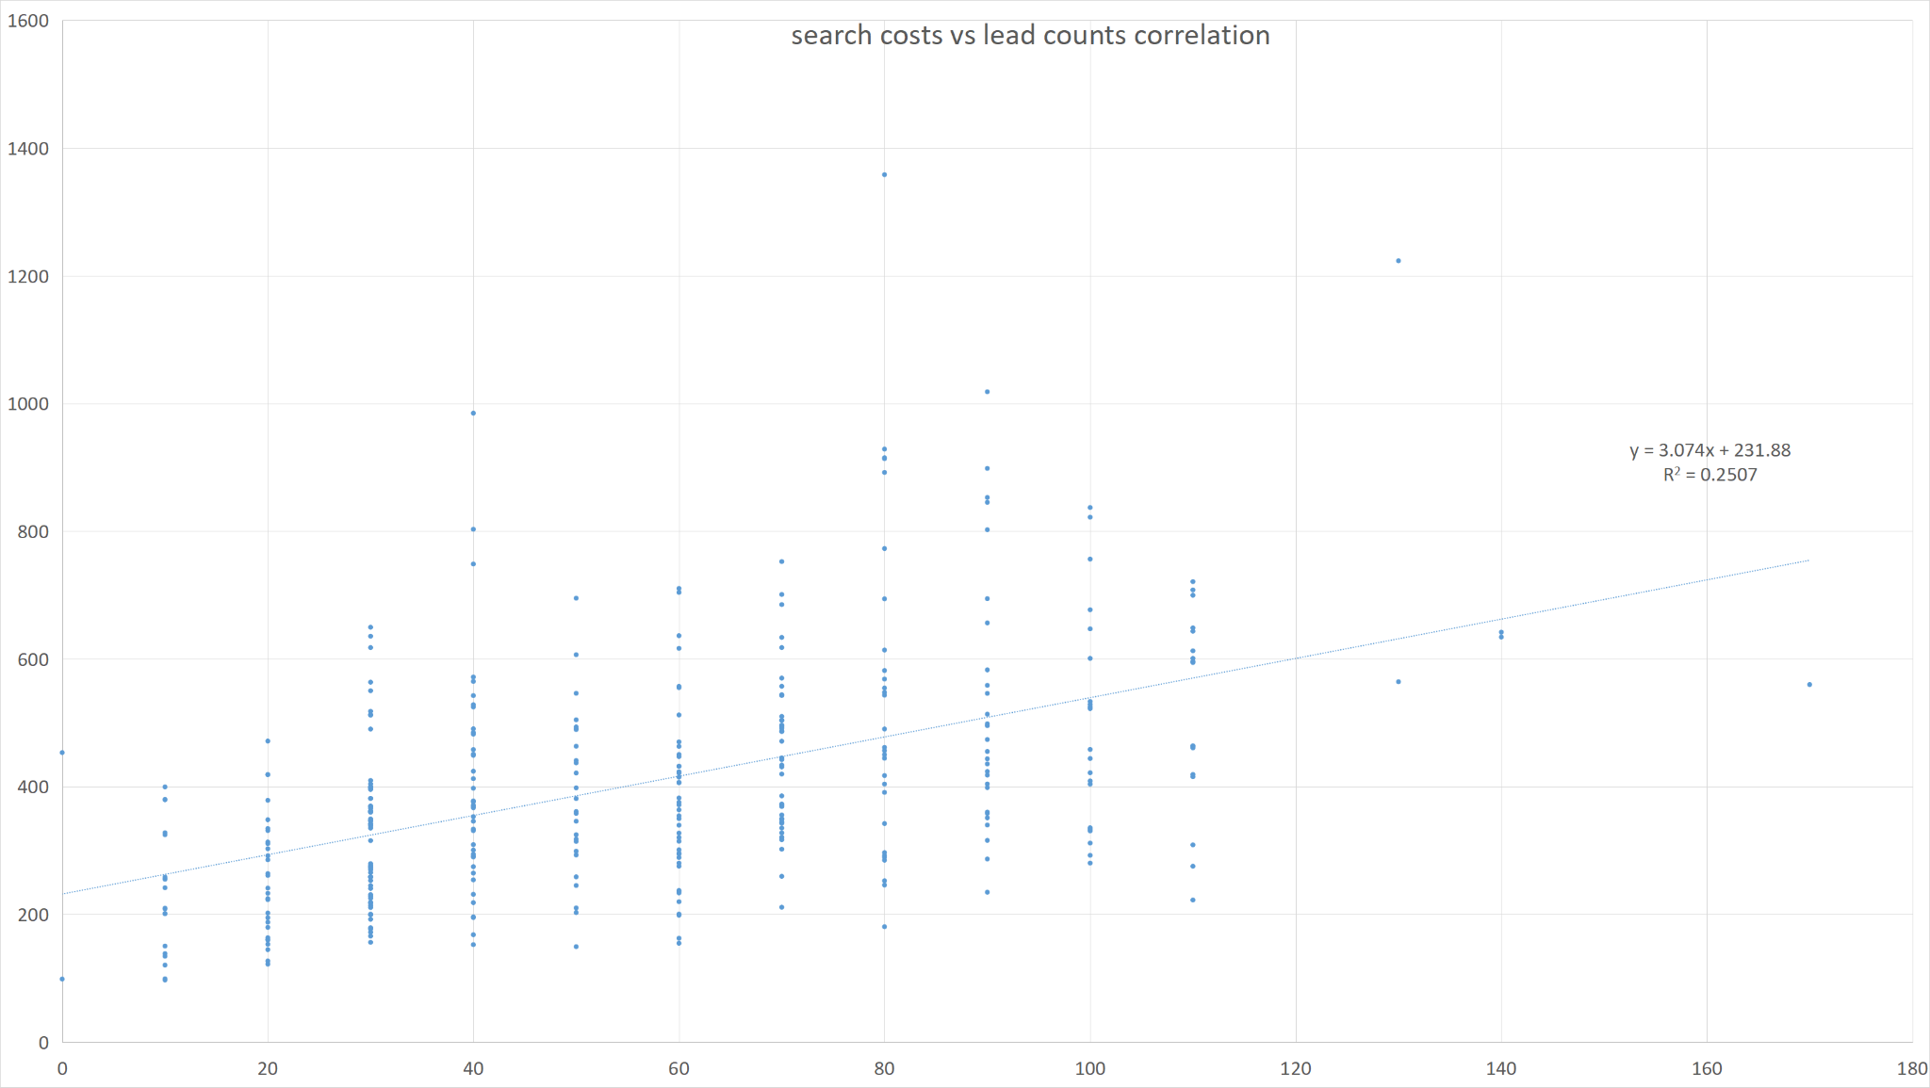
Lead vs Cost Correlation by channel - Search
Low Correlation at 0.2507
Every dollar/euro spend returns 3.074 leads.

Slide 13
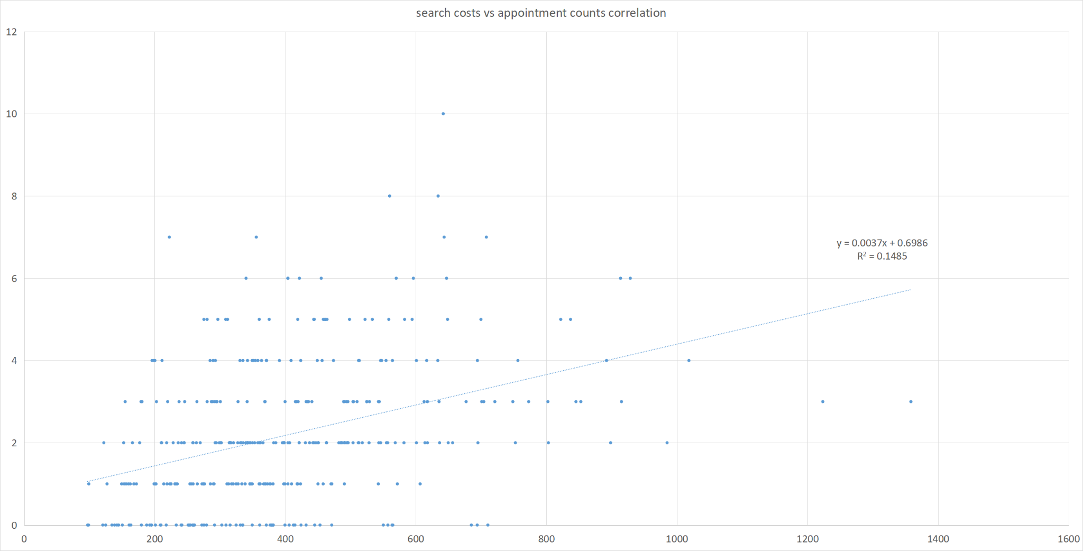
Appointment vs Cost Correlation by channel - Search
Low Correlation at 0.1485
Every dollar/euro spend returns 0.0037 appointment.

Slide 14
Recommendations
Google Display conversion between lead to appointment is very low and we do not have cost data. If it is free then we should let it be, but if it has high cost then we may need to reconsider this channel.
Invest more in Native channel due to the high-correlation and high return between cost and leads/appointments.
Keep investing in Social channel due to the reasonable correlation and decent return between cost and leads/appointments.
Avoid investing in Search channel if cost is a concern due to low correlation and even with decent return between cost and leads/appointments.

